Slide 1
Chapter 7: Synchronization Examples

Slide 2
Outline
Explain the bounded-buffer synchronization problem
Explain the readers-writers synchronization problem
Explain and dining-philosophers synchronization problems
Describe the tools used by Linux and Windows to solve synchronization problems.
Illustrate how POSIX and Java can be used to solve process synchronization problems

Slide 3
Classical Problems of Synchronization
Classical problems used to test newly-proposed synchronization schemes
Bounded-Buffer Problem
Readers and Writers Problem
Dining-Philosophers Problem

Slide 4
Bounded-Buffer Problem
n buffers, each can hold one item
Semaphore mutex initialized to the value 1
Semaphore full initialized to the value 0
Semaphore empty initialized to the value n

Slide 5
Bounded Buffer Problem (Cont.)
The structure of the producer process
while (true) {
... /* produce an item in next_produced */
...
wait(empty);
wait(mutex);
... /* add next produced to the buffer */
...
signal(mutex);
signal(full);
}

Slide 6
Bounded Buffer Problem (Cont.)
The structure of the consumer process
while (true) {
wait(full);
wait(mutex);
... /* remove an item from buffer to next_consumed */
...
signal(mutex);
signal(empty);
... /* consume the item in next consumed */
... }

Slide 7
Readers-Writers Problem
A data set is shared among a number of concurrent processes
Readers – only read the data set; they do not perform any updates
Writers – can both read and write
Problem – allow multiple readers to read at the same time
Only one single writer can access the shared data at the same time
Several variations of how readers and writers are considered – all involve some form of priorities

Slide 8
Readers-Writers Problem (Cont.)
Shared Data
Data set
Semaphore rw_mutex initialized to 1
Semaphore mutex initialized to 1
Integer read_count initialized to 0

Slide 9
Readers-Writers Problem (Cont.)
The structure of a writer process
while (true) { wait(rw_mutex);
... /* writing is performed */
...
signal(rw_mutex);
}

Slide 10
Readers-Writers Problem (Cont.)
The structure of a reader process
while (true){ wait(mutex); read_count++; if (read_count == 1) /* first reader */
wait(rw_mutex);
signal(mutex);
... /* reading is performed */
...
wait(mutex); read_count--; if (read_count == 0) /* last reader */
signal(rw_mutex);
signal(mutex);
}

Slide 11
Readers-Writers Problem Variations
The solution in previous slide can result in a situation where a writer process never writes. It is referred to as the “First reader-writer” problem.
The “Second reader-writer” problem is a variation the first reader-writer problem that state:
Once a writer is ready to write, no “newly arrived reader” is allowed to read.
Both the first and second may result in starvation. leading to even more variations
Problem is solved on some systems by kernel providing reader-writer locks

Slide 12

Dining-Philosophers Problem
N philosophers’ sit at a round table with a bowl of rice in the middle.
They spend their lives alternating thinking and eating.
They do not interact with their neighbors.
Occasionally try to pick up 2 chopsticks (one at a time) to eat from bowl
Need both to eat, then release both when done
In the case of 5 philosophers, the shared data
Bowl of rice (data set)
Semaphore chopstick [5] initialized to 1

Slide 13
Dining-Philosophers Problem Algorithm
Semaphore Solution
The structure of Philosopher i :
while (true){
wait (chopstick[i] );
wait (chopStick[ (i + 1) % 5] );
/* eat for awhile */
signal (chopstick[i] );
signal (chopstick[ (i + 1) % 5] );
/* think for awhile */
}
What is the problem with this algorithm?

Slide 14
Monitor Solution to Dining Philosophers
monitor DiningPhilosophers
{
enum {THINKING; HUNGRY, EATING} state [5];
condition self [5];
void pickup (int i) {
state[i] = HUNGRY;
test(i);
if (state[i] != EATING) self[i].wait;
}
void putdown (int i) {
state[i] = THINKING;
// test left and right neighbors
test((i + 4) % 5);
test((i + 1) % 5);
}

Slide 15
Solution to Dining Philosophers (Cont.)
void test (int i) {
if ((state[(i + 4) % 5] != EATING) &&
(state[i] == HUNGRY) &&
(state[(i + 1) % 5] != EATING) ) {
state[i] = EATING ;
self[i].signal () ;
}
}
initialization_code() {
for (int i = 0; i < 5; i++)
state[i] = THINKING;
}
}

Slide 16
Solution to Dining Philosophers (Cont.)
Each philosopher “i” invokes the operations pickup() and putdown() in the following sequence:
DiningPhilosophers.pickup(i);
/** EAT **/
DiningPhilosophers.putdown(i);
No deadlock, but starvation is possible

Slide 17
POSIX Synchronization
POSIX API provides
mutex locks
semaphores
condition variable
Widely used on UNIX, Linux, and macOS

Slide 18
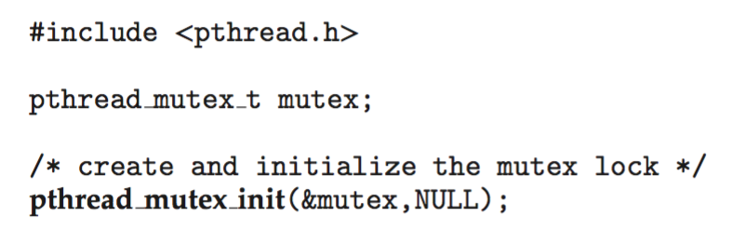
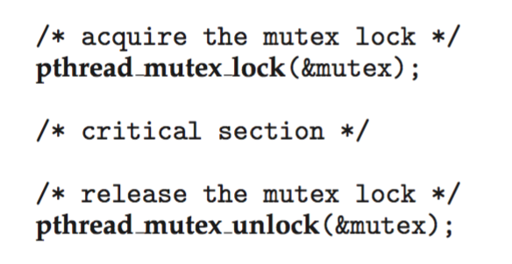
POSIX Mutex Locks
Creating and initializing the lock
Acquiring and releasing the lock

Slide 19
POSIX Semaphores
POSIX provides two versions – named and unnamed.
Named semaphores can be used by unrelated processes, unnamed cannot.

Slide 20
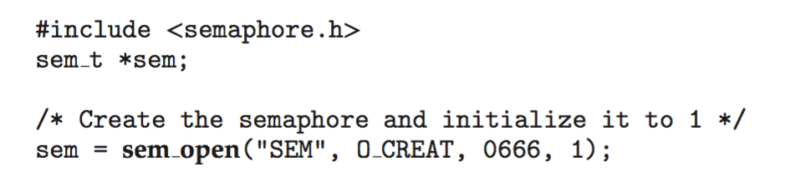
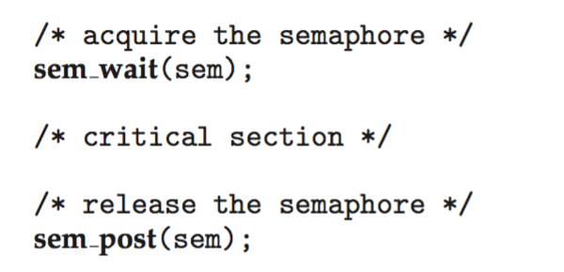
POSIX Named Semaphores
Creating an initializing the semaphore:
Another process can access the semaphore by referring to its name SEM.
Acquiring and releasing the semaphore:

Slide 21
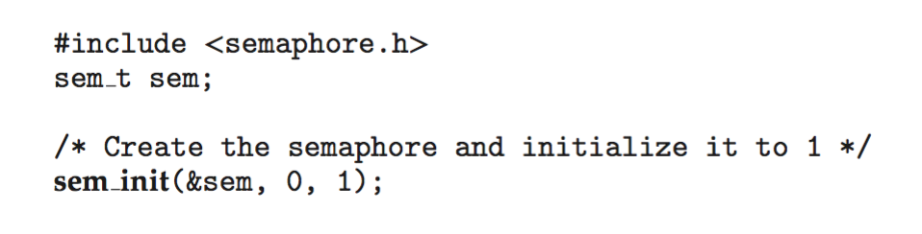
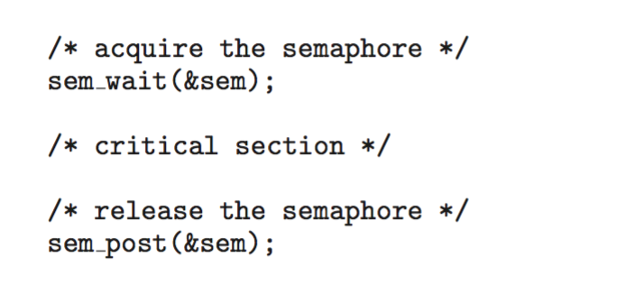
POSIX Unnamed Semaphores
Creating an initializing the semaphore:
Acquiring and releasing the semaphore:

Slide 22
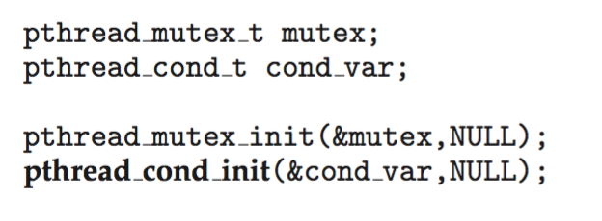
POSIX Condition Variables
Since POSIX is typically used in C/C++ and these languages do not provide a monitor, POSIX condition variables are associated with a POSIX mutex lock to provide mutual exclusion: Creating and initializing the condition variable:

Slide 23
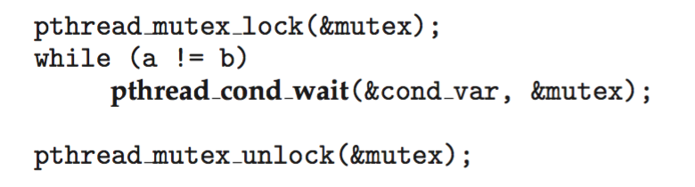
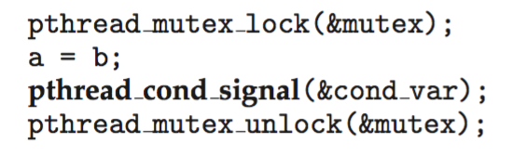
POSIX Condition Variables
Thread waiting for the condition a == b to become true:
Thread signaling another thread waiting on the condition variable:

Slide 24
End of Chapter 7

